Slide 1
MRA Project ML 1
Name- Hitesh Dadhich
Batch- Dsba_May2022
Email- Dadhichh7@gmail.com

Slide 2
Table OF CONTENT
Agenda & Executive Summary of the data
Problem Statement
About Data
Exploratory Analysis and Inferences
Univariate, Bivariate, and multivariate analysis
Weekly, Monthly, Quarterly, Yearly Trends in Sales
Sales Across different Categories of different features
Inferences
Customer Segmentation using RFM analysis
What is RFM?
What all parameters used and assumptions made
Output table head
KNIME used, Workflow image to be put
Inferences from RFM Analysis and identified segments
Who are your best customers
Which customers are on the verge of churning
Who are your lost customers
Who are your loyal customers

Slide 3
PROBLEM STATEMENT
An automobile parts manufacturing company has collected data of transactions for 3 years. They do not have any in-house data science team, thus they have hired you as their consultant. Your job is to use your magical data science skills to provide them with suitable insights about their data and their customers.

Slide 4
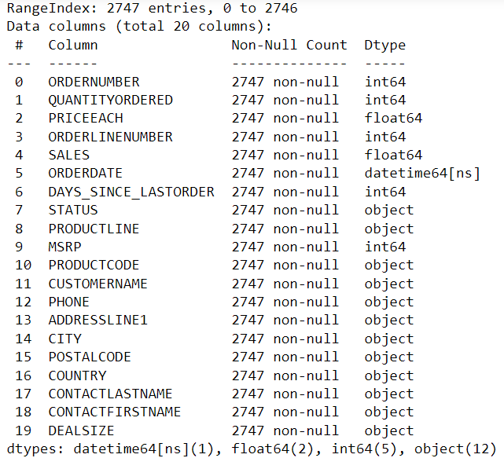
ABOUT DATA
Shape - Data has 2747 Rows and 20 columns.
Data information –

Slide 5
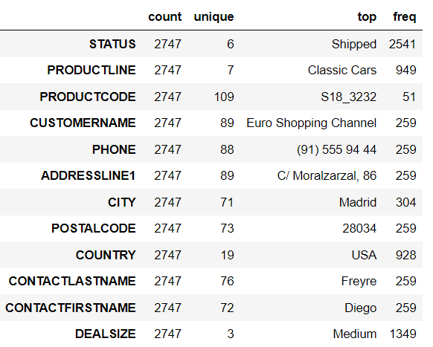
Descriptive summary for categorical variables -

Slide 6
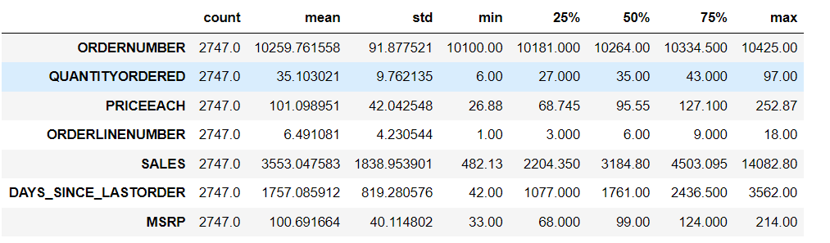
Descriptive summary for numerical variables -
Assumptions –
1. We don’t have any null value present in the data.
2. we have 4 data types integer, float, object and datetime.
3. Most of the order shipped to city Madrid and mostly for classic cars.
4. On an average 35 of order quantity placed.
5. longest duration since last order was placed is 3652 days .

Slide 7
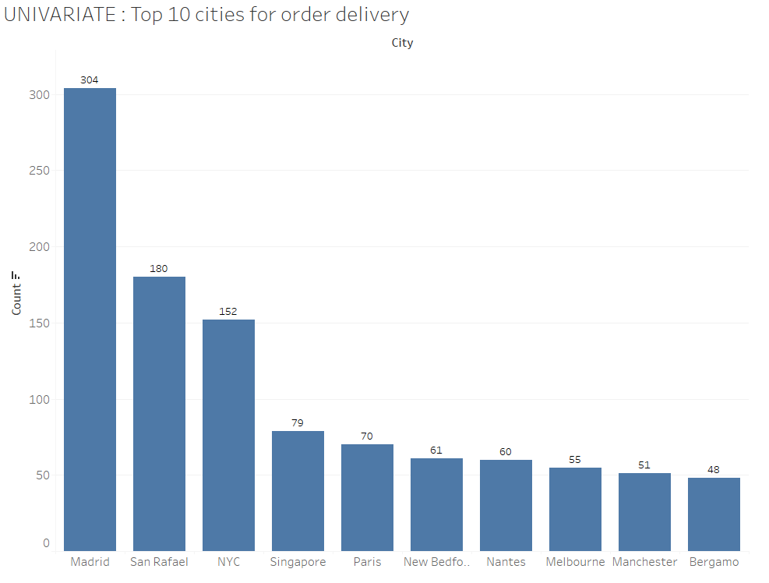
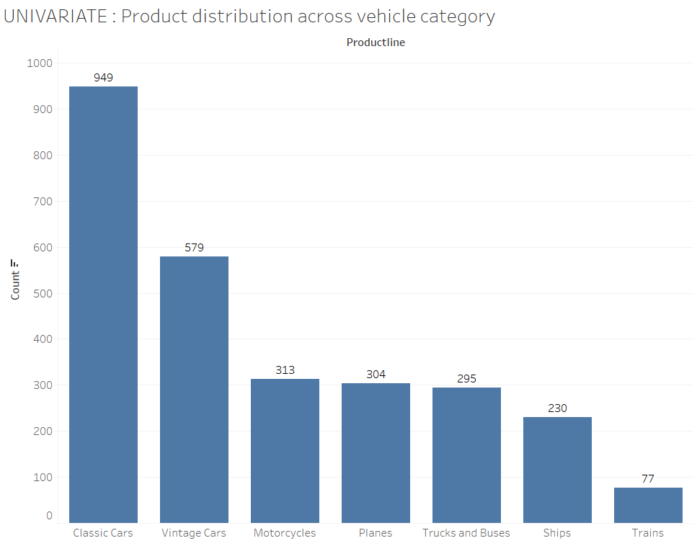
UNIVARIATE, BIVARIATE & MULTIVARIATE ANALYSIS
UNIVARIATE

Slide 8
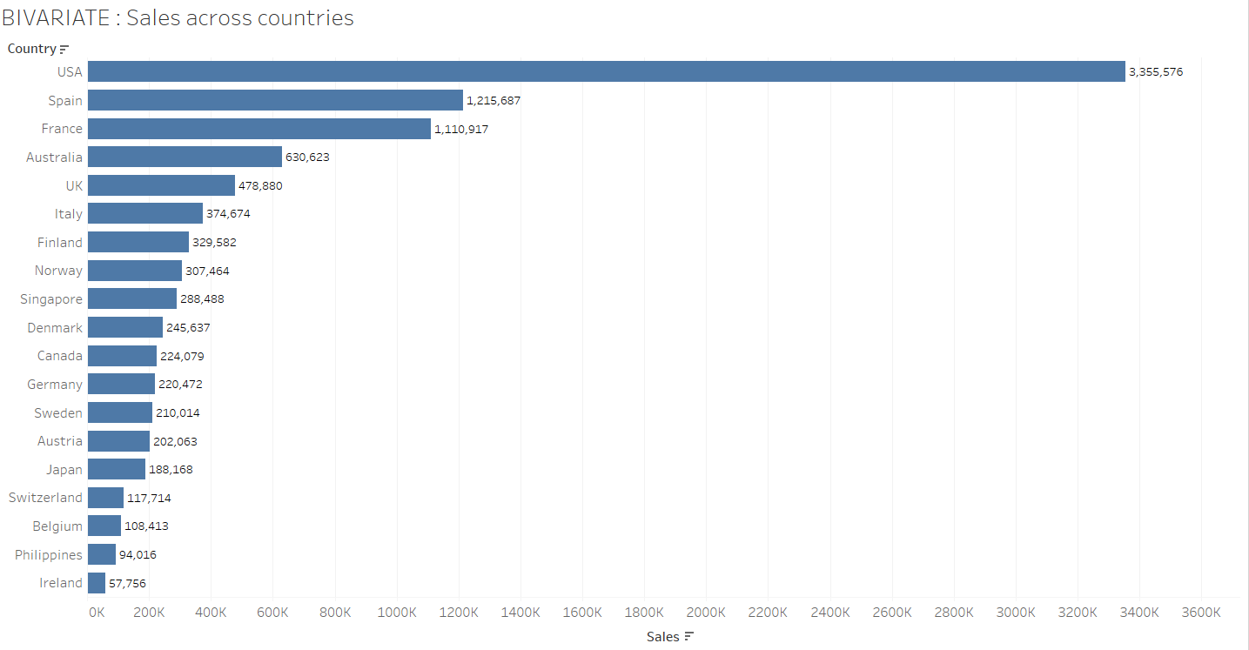
BIVARIATE

Slide 9
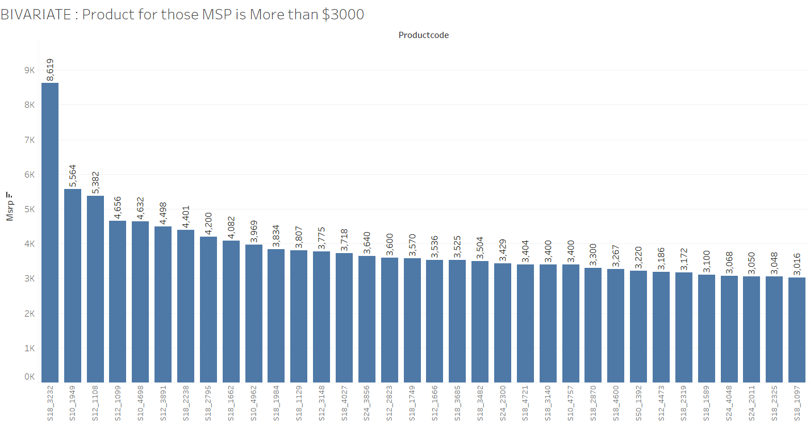
BIVARIATE

Slide 10
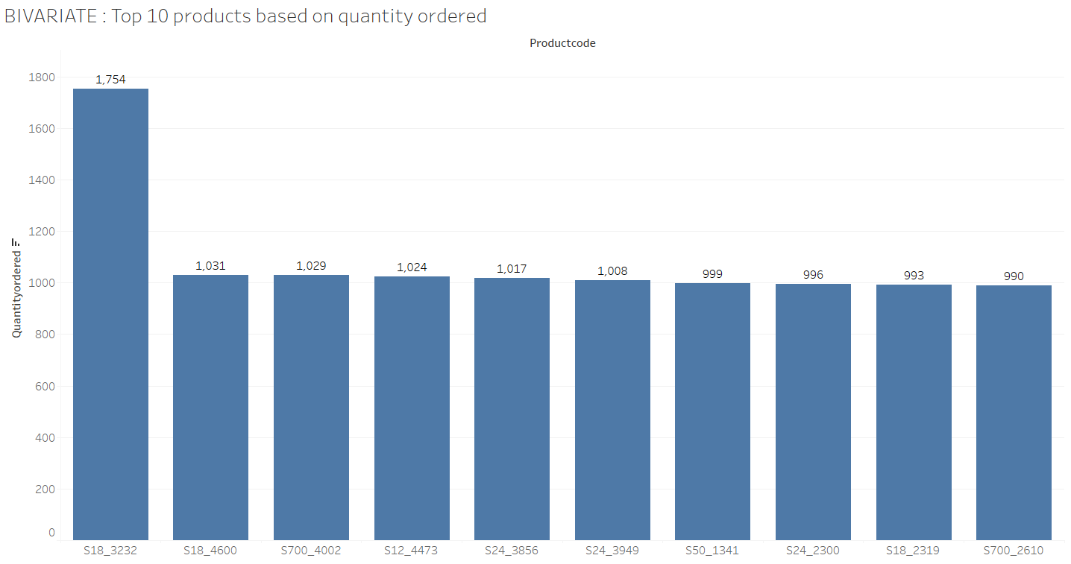
BIVARIATE

Slide 11
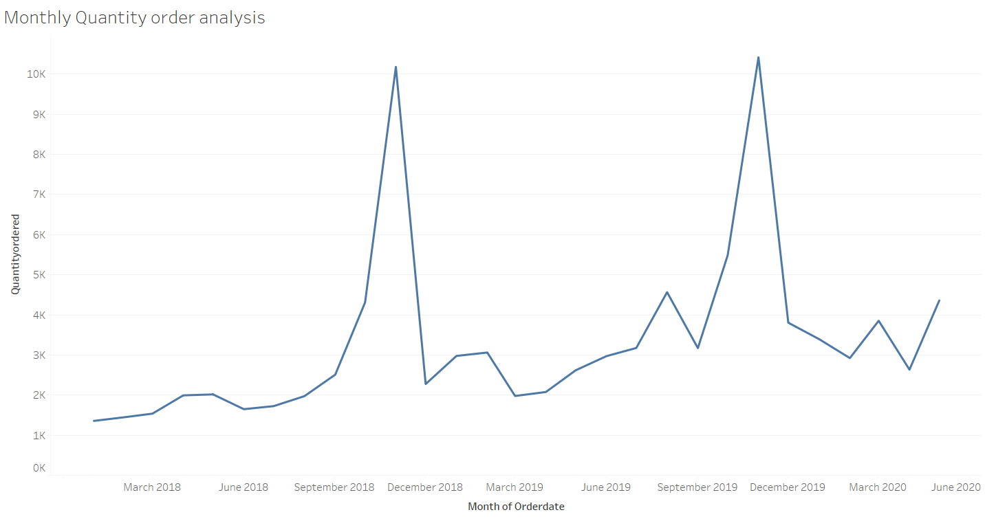
BIVARIATE

Slide 12
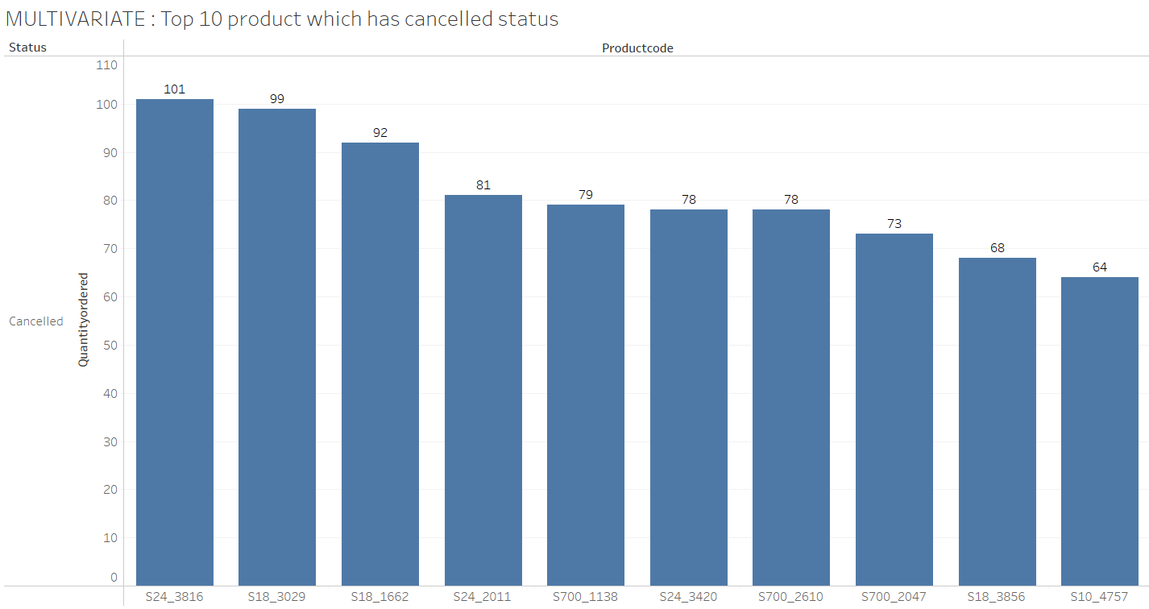
MULTIVARIATE

Slide 13
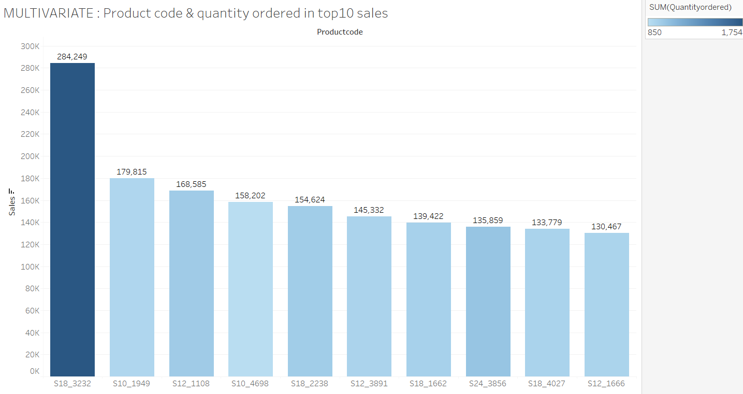
MULTIVARIATE

Slide 14
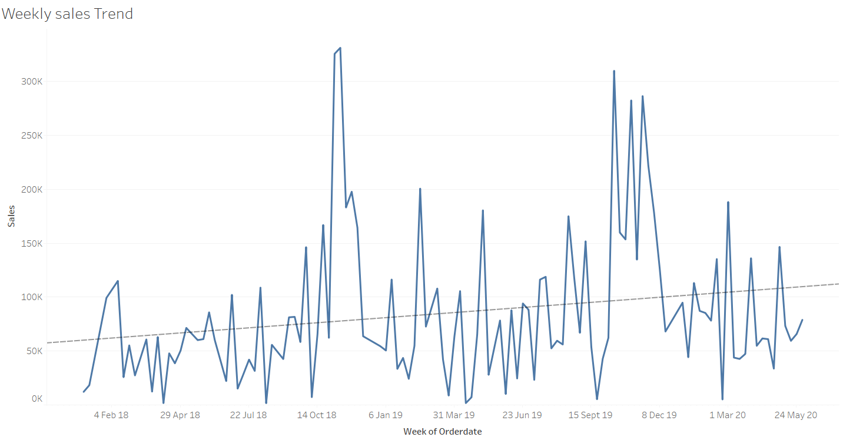
Trend analysis

Slide 15
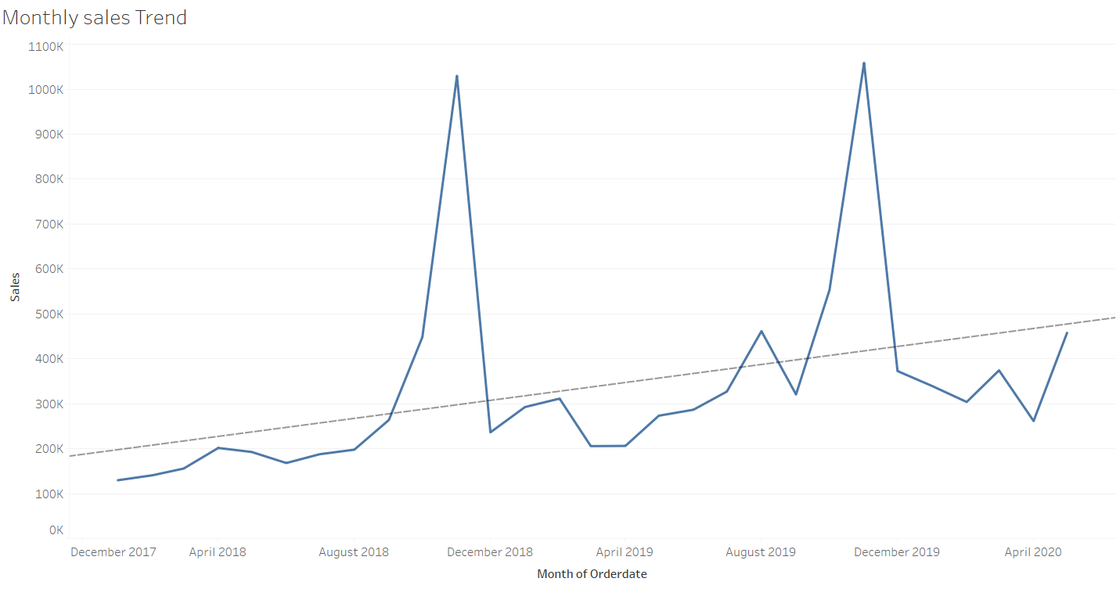
TREND ANALYSIS

Slide 16
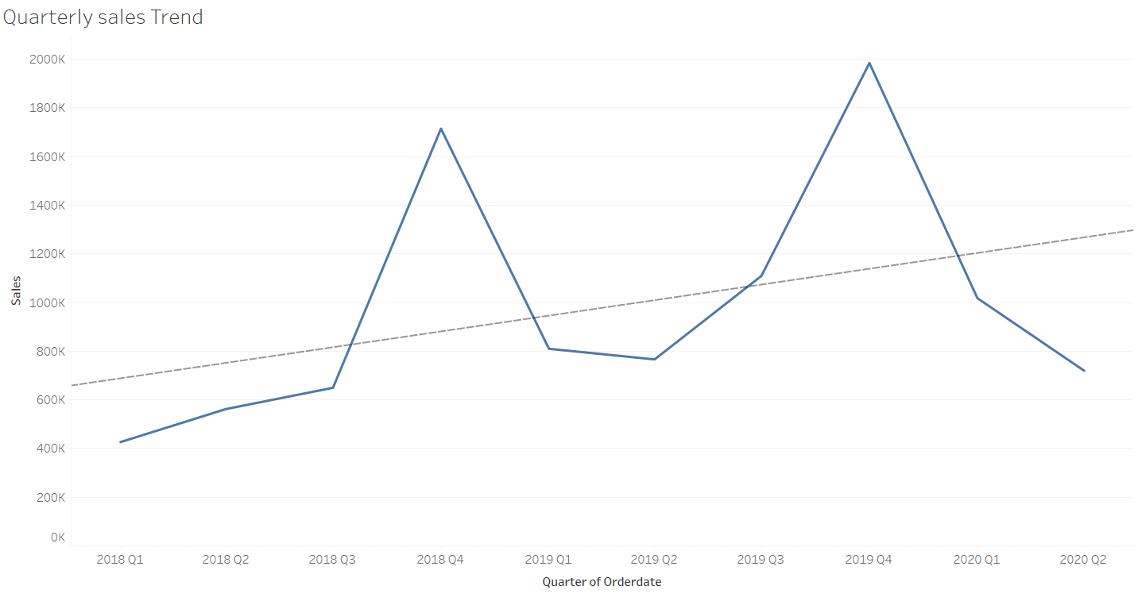
TREND ANALYSIS

Slide 17
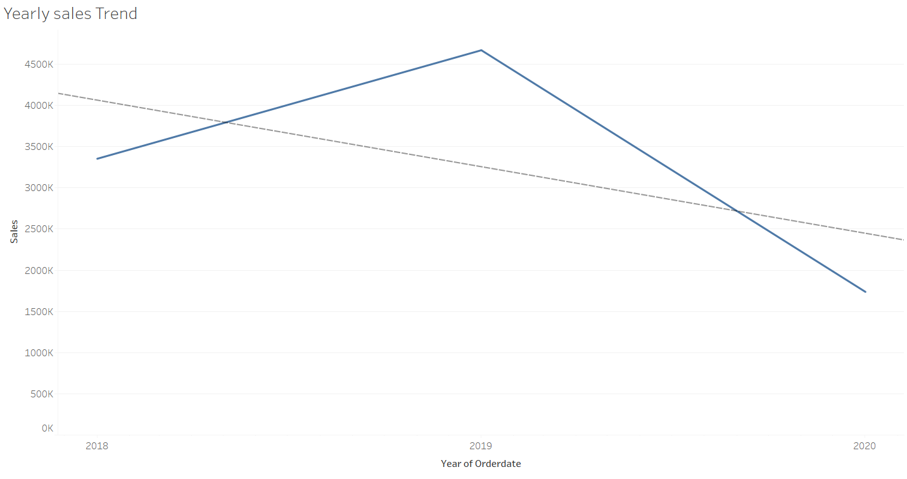
TREND ANALYSIS

Slide 18
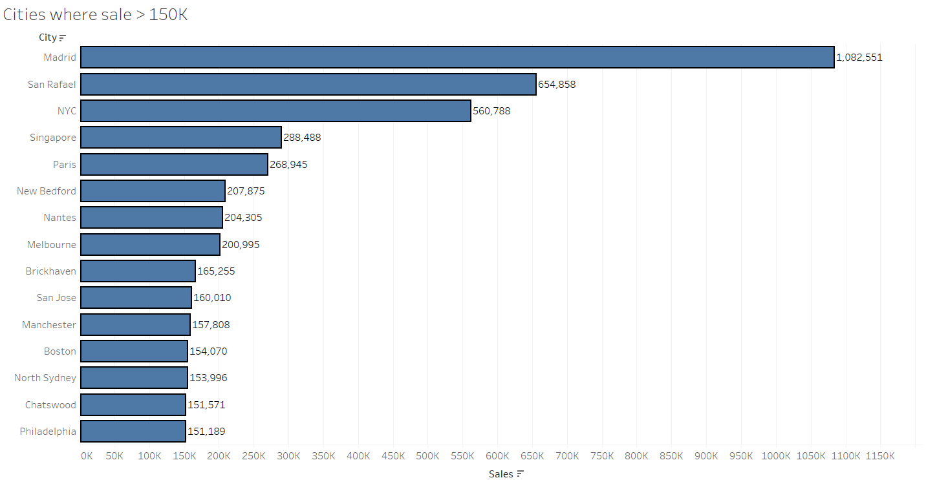
Sales Analysis

Slide 19
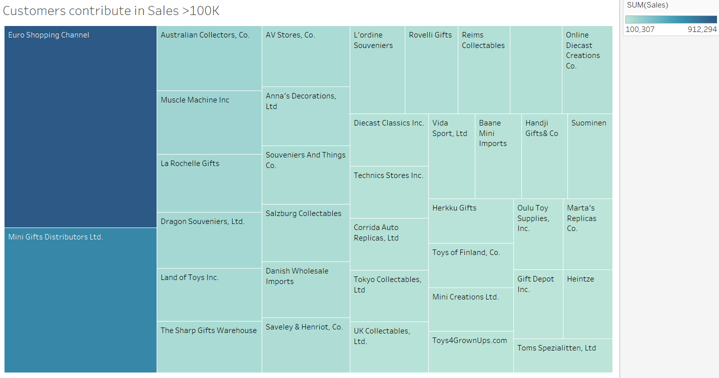
Sales Analysis

Slide 20
INFERENCES –
1. Maximum sales is for country USA and minimum is for Ireland.
2. Maximum order placed for classic cars and minimum is for trains.
3. Product code S18_3232 has highest MSRP (Manufacturer's Suggested Retail Price).
4. Maximum quantity ordered is also for product code S18_3232.
5. Product code S18_3232 seems to be high demand product and so it has high MSRP.
6. We have 29 months sales data available for our analysis.
7. Maximum order cancelled is for product code S24_3816 need to check the reason of cancellation.
8. As per weekly sales trend it shows increase in sales.
9. As per monthly sales trend it shows increase in sales.
10. As per quarterly sales trend it shows increase in sales.
11. As per yearly sales trend it shows decrease in sales.
12. Highest sales observed in the November month but after November there is drastic decrease in next December month.
13. After November 2019 high drop in sales occurs and it’s not improving as compare to previous year trend .
14. Madrid is the best city for sales and it does not belongs to the country USA which has highest sales in countries.
15. Customer Euro Shopping Channel contribute highest in sales so we can say he is most valuable customers.

Slide 21
WHAT IS RFM
Rfm stands for Recency, Frequency and Monetary value Where
Recency shows the freshness of customers activity like when last time customers visit.
Frequency shows number of transactions or visit of the customers .
Monetary value shows purchasing power of the customers like how much he can spend in his visit.
Based on RFM value (XXX) we can do customer segamatation and can find out which customer is loyal and which can churn.

Slide 22
PARAMETERS AND ASSUMPTION FOR RFM
RFM analysis scores customers on each of the three main factors. Generally, a score from 1 to 5 is given, with 5 being the highest.
We need to calculate Recency, Frequency and monetary values to do RFM analysis.
We have sales column in the data and that is our Monetary value and higher the Monetary value means higher the amount spend by customers.
We have order number for each customers and unique count of these orders will give us frequency so higher the frequency means the customer visit very often.
We have column order date and this can give us recency so to get recency we are taking last date may 31,2020 as target date and count last shopping date by taking different of last date and order date.
In recency higher the value means customer recently visit the store.
We used 4 bins with quantiles difference of 0.25 and for recency, lower the binsize better the recency and for Frequency, Monetary it’s opposite.

Slide 23
OUTPUT TABLE HEAD -
We export the data in csv file with RFM value and create a pivot table shown below :
We have total 89 unique customers and out of 89, 9 customers have best RFM values 444 and 5 customers have second best RFM value 344 so these are very loyal and high spend making customers and we can give some special promotion to keep them active.
Count of CUSTOMERNAME |  | MONETARY
RECENCY | FREQUENCY | 4 | 3 | 2 | 1
4 | 4 | 9 | 2
 | 2 | 1 | 3 | 6 | 2
3 | 4 | 5 |  |  | 1
 | 2 | 1 | 7 | 3 | 4
 | 1 |  |  |  | 1
2 | 4 | 1 | 1 | 2
 | 2 | 4 | 3 | 3 | 1
 | 1 |  | 2 | 3 | 2
1 | 2 | 1 | 1
 | 1 |  | 3 | 5 | 12

Slide 24
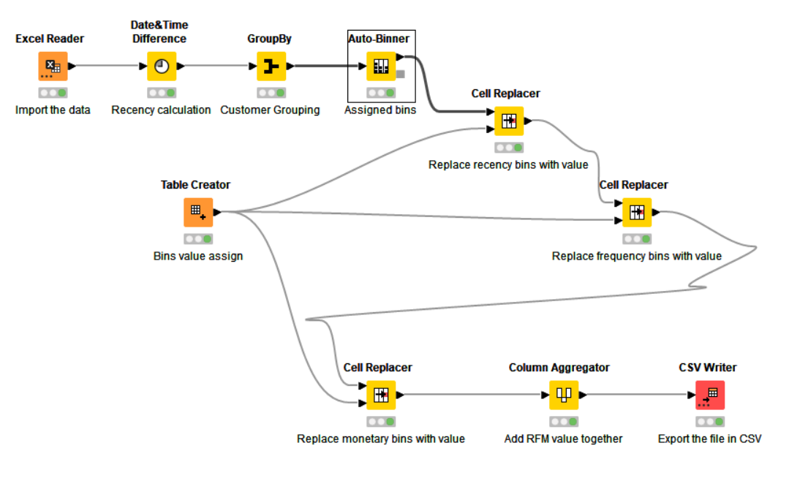
KNIME WORKFLOW -

Slide 25
BEST CUSTOMERS -
For best customers RFM should be - 444
RECENCY2 | 4
FREQUENCY | 4
MONETARY | 4
Customer Name | SALES | Average of QUANTITYORDERED | NO. of days since last order
Diecast Classics Inc. | 122138.14 | 35.83870968 | 1
Euro Shopping Channel | 912294.11 | 36.01158301 | 0
Mini Gifts Distributors Ltd. | 654858.06 | 35.36666667 | 2
Souveniers And Things Co. | 151570.98 | 34.80434783 | 2
La Rochelle Gifts | 180124.9 | 34.56603774 | 0
Salzburg Collectables | 149798.63 | 36.05 | 14

Slide 26
CUSTOMERS TO CHURN -
Customer those who have low recency are on verge to churn :
Customer Name | SALES | Average of QUANTITYORDERED | NO. of days since last order
Amica Models & Co. | 94117.26 | 32.42307692 | 265
Herkku Gifts | 111640.28 | 33.55172414 | 271
Marta's Replicas Co. | 103080.38 | 36.14814815 | 231
Saveley & Henriot, Co. | 142874.25 | 34.82926829 | 456
Vida Sport, Ltd | 117713.56 | 34.77419355 | 275

Slide 27
LOST CUSTOMERS -
Customers those have low recency are lost customers :
Customer Name | SALES | Average of QUANTITYORDERED | NO. of days since last order
West Coast Collectables Co. | 46084.64 | 39.30769231 | 488
Signal Collectibles Ltd. | 50218.51 | 34.26666667 | 476
Saveley & Henriot, Co. | 142874.25 | 34.82926829 | 456
Osaka Souveniers Co. | 67605.07 | 34.6 | 414
Collectable Mini Designs Co. | 87489.23 | 38.16 | 460
Daedalus Designs Imports | 69052.41 | 34.95 | 465
Diecast Collectables | 70859.78 | 38.61111111 | 401
Double Decker Gift Stores, Ltd | 36019.04 | 29.75 | 495
CAF Imports | 49642.05 | 36 | 439

Slide 28
LOYAL CUSTOMERS -
Those customers are loyal who frequently purchase items and spend good amount :
Customer Name | SALES | Average of QUANTITYORDERED | NO. of days since last order
Mini Gifts Distributors Ltd. | 654858.06 | 35.36666667 | 2
Euro Shopping Channel | 912294.11 | 36.01158301 | 0
La Rochelle Gifts | 180124.9 | 34.56603774 | 0
Souveniers And Things Co. | 151570.98 | 34.80434783 | 2
Diecast Classics Inc. | 122138.14 | 35.83870968 | 1

Slide 29
Conclusion -
# As per the RFM analysis we found list of those customers which are about to churn and which customers we have lost and which customers are best customers.
# Based on this analysis we can plan our strategy like those customers who are about to churn we can review what are the items they used to buy more in past and can arrange those items.
# Similarly for those customers who haven't shopped from long time but their monetary value was very high we can send them a reminder with some offers.

